Slide 1


DPABI: Data Processing & Analysis for (Resting-State) Brain Imaging
严超赣
Chao-Gan Yan, Ph.D.
yancg@psych.ac.cn
http://rfmri.org/yan
Institute of Psychology, Chinese Academy of Sciences

Slide 2
Outline
Overview
Data Preparation
Preprocessing
R-fMRI measures Calculation
Quality Control
Standardization
Statistical Analysis
Results Viewing
2

Slide 3
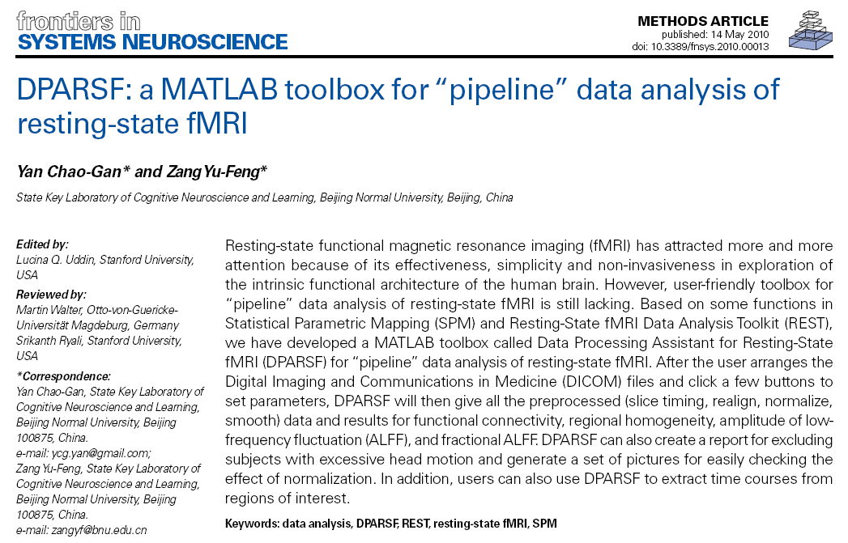
DPARSF
(Yan and Zang, 2010)

Slide 4
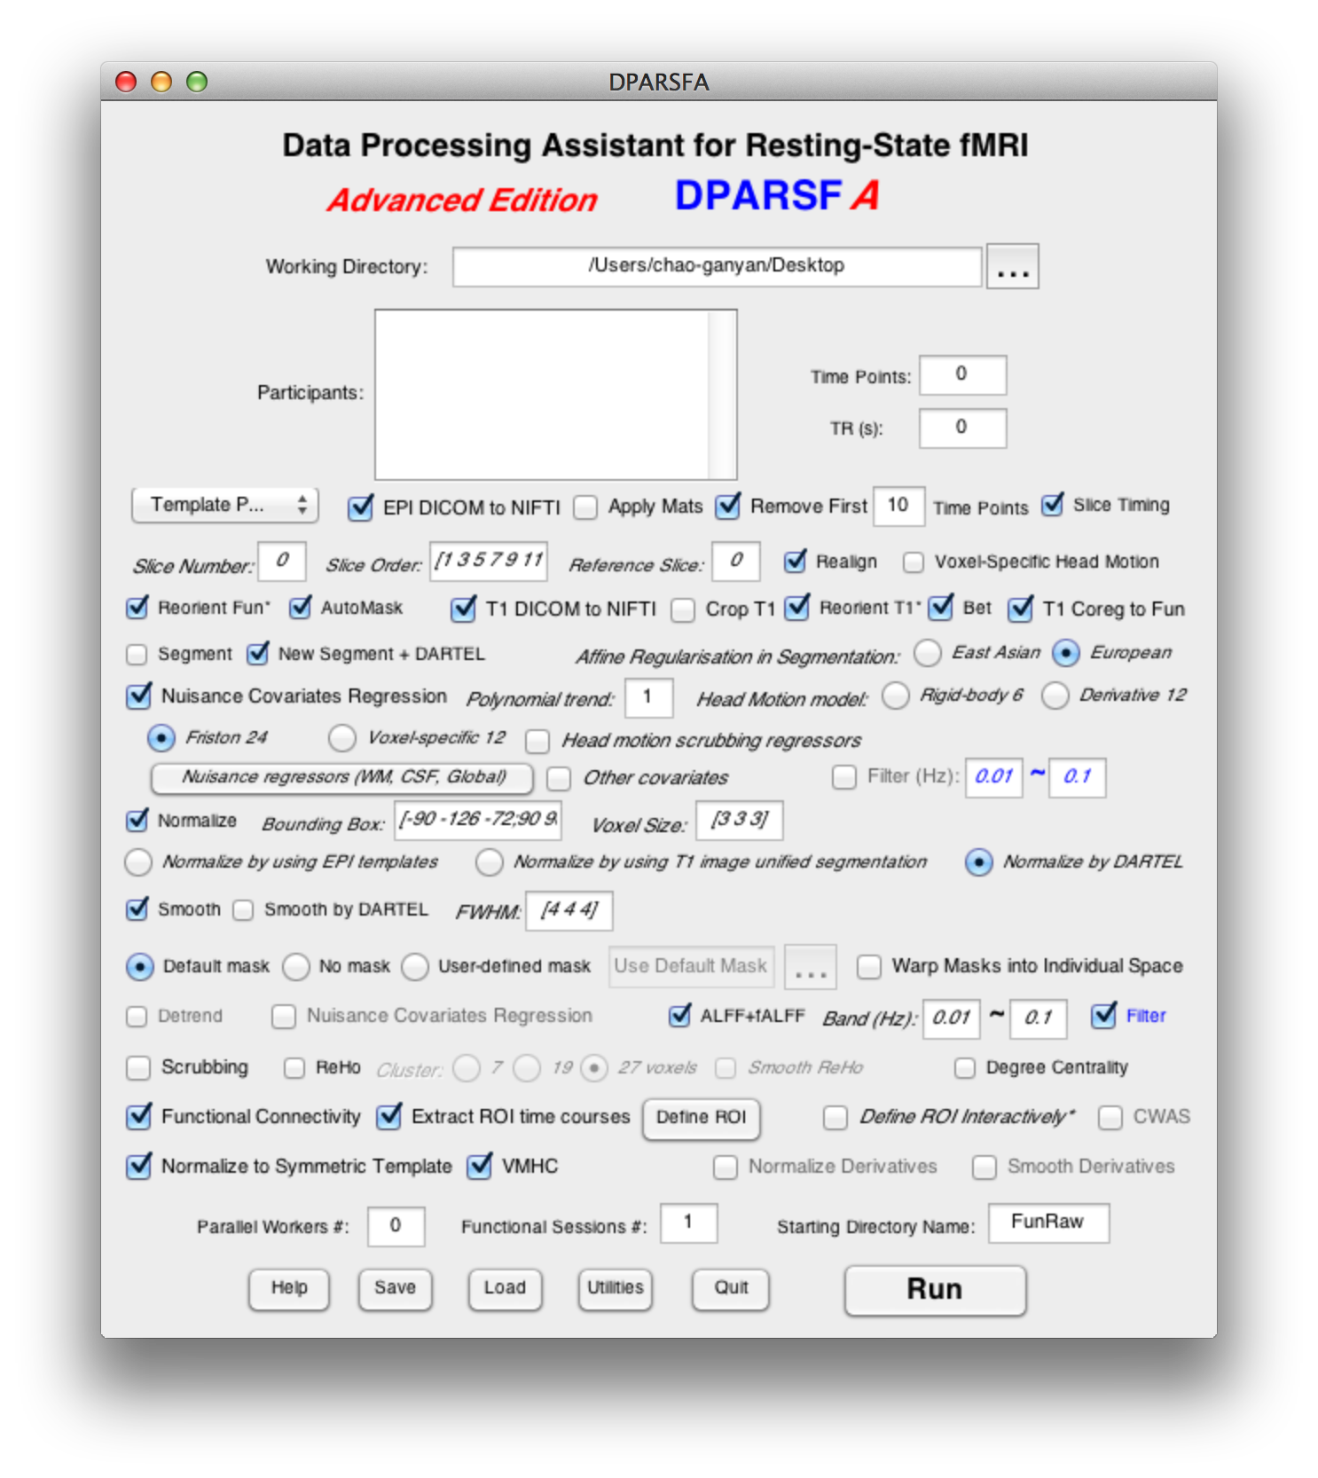
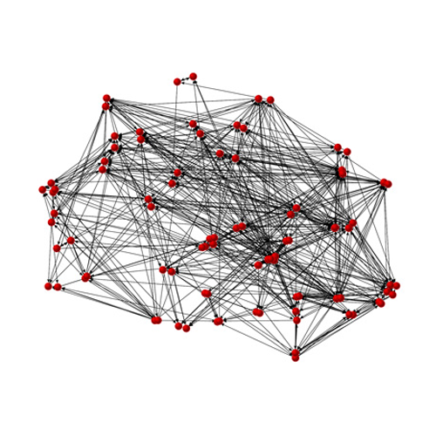
Data Processing Assistant for Resting-State fMRI (DPARSF)
Yan and Zang, 2010. Front Syst Neurosci.
http://rfmri.org/DPARSF

Slide 5
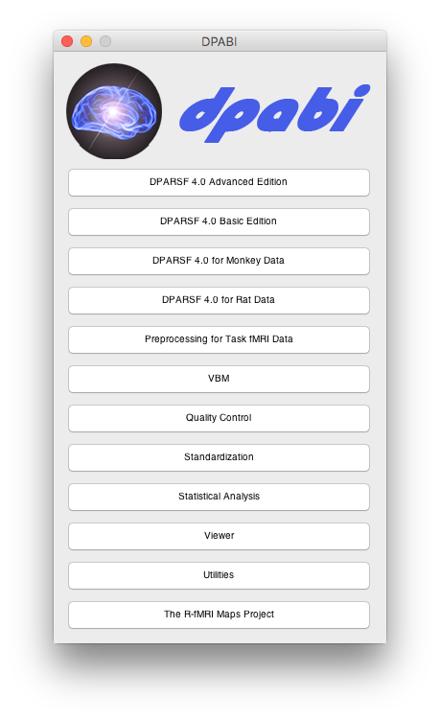


DPABI: a toolbox for Data Processing & Analysis of Brain Imaging
License: GNU GPL
Chao-Gan Yan Programmer Initiator
Xin-Di Wang Programmer
http://rfmri.org/dpabi
http://dpabi.org

Slide 6
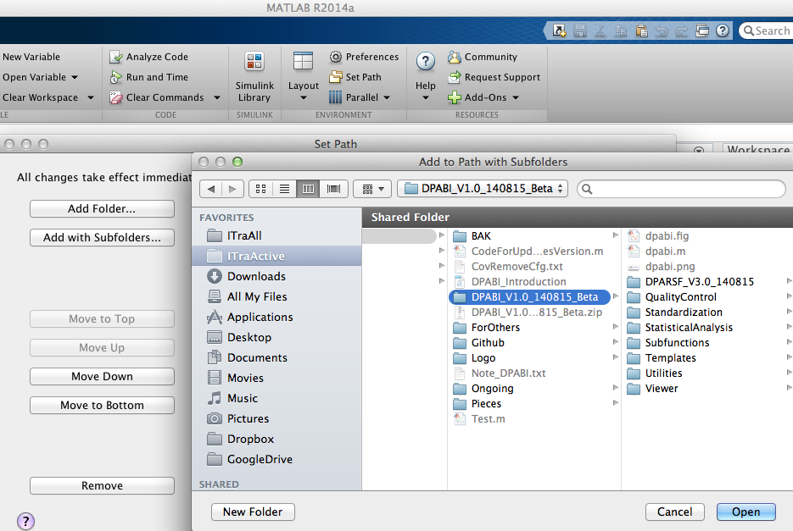
6

Slide 7
Outline
Overview
Data Preparation
Preprocessing
R-fMRI measures Calculation
Quality Control
Standardization
Statistical Analysis
Results Viewing
7

Slide 8
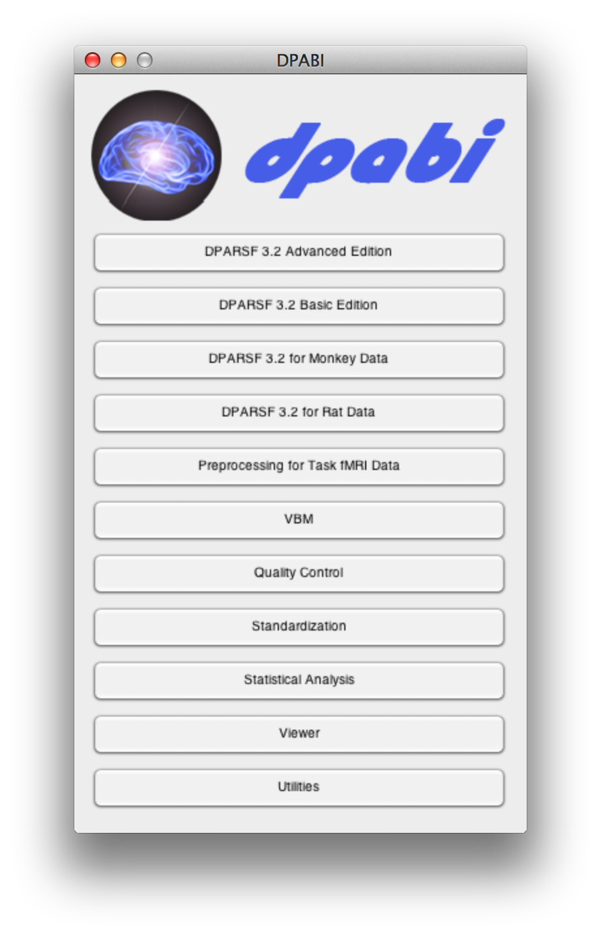
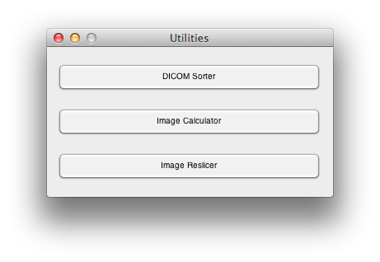

Slide 9
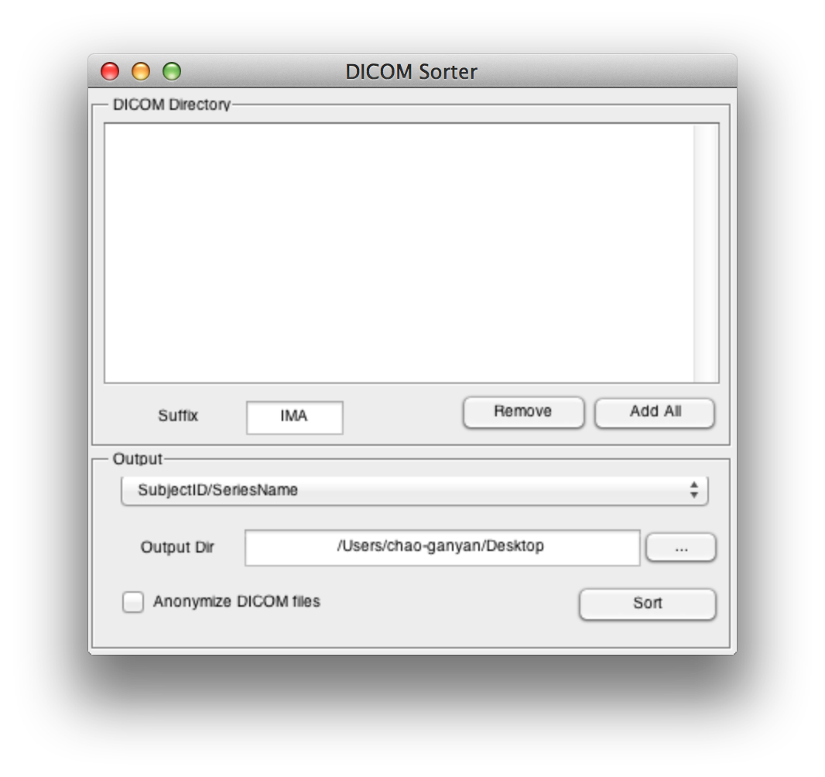
IMA
dcm
none

Slide 10
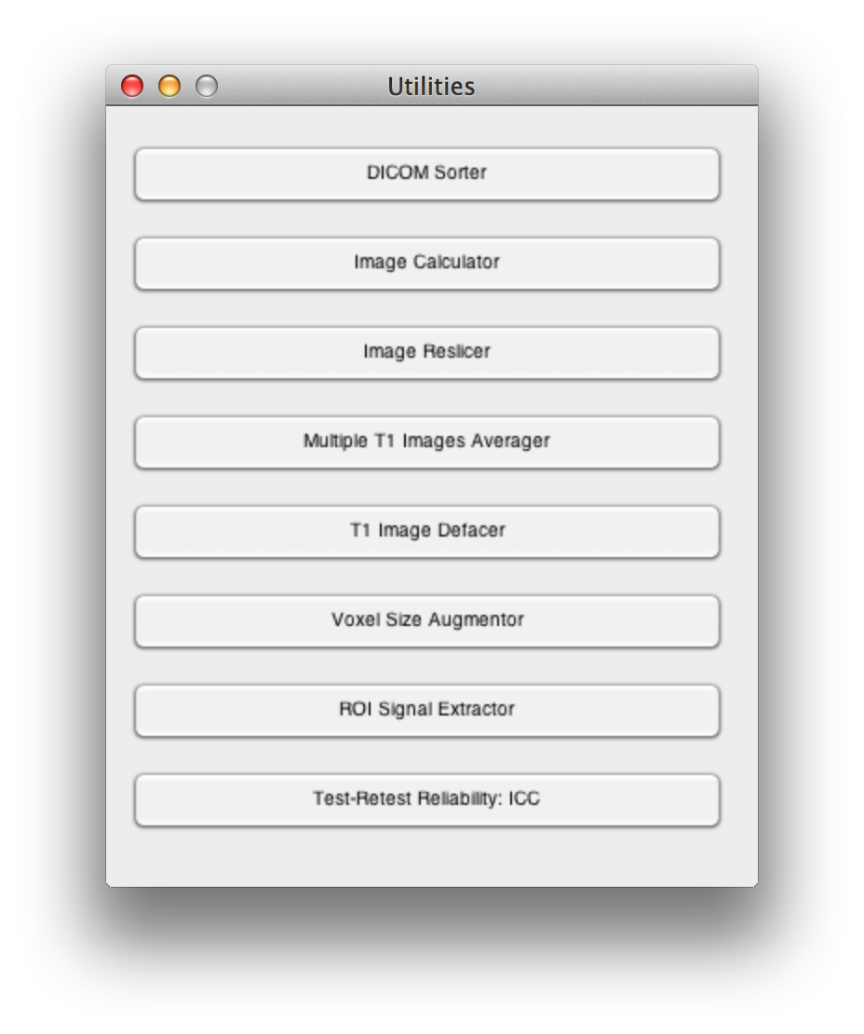

Slide 11
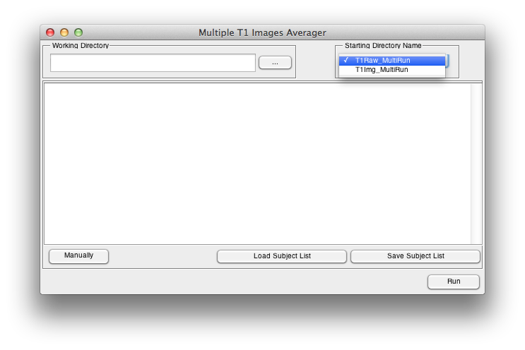
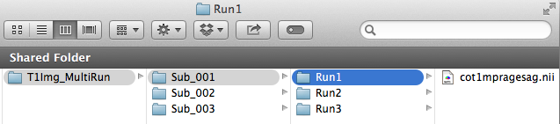
Coregister and average

Slide 13
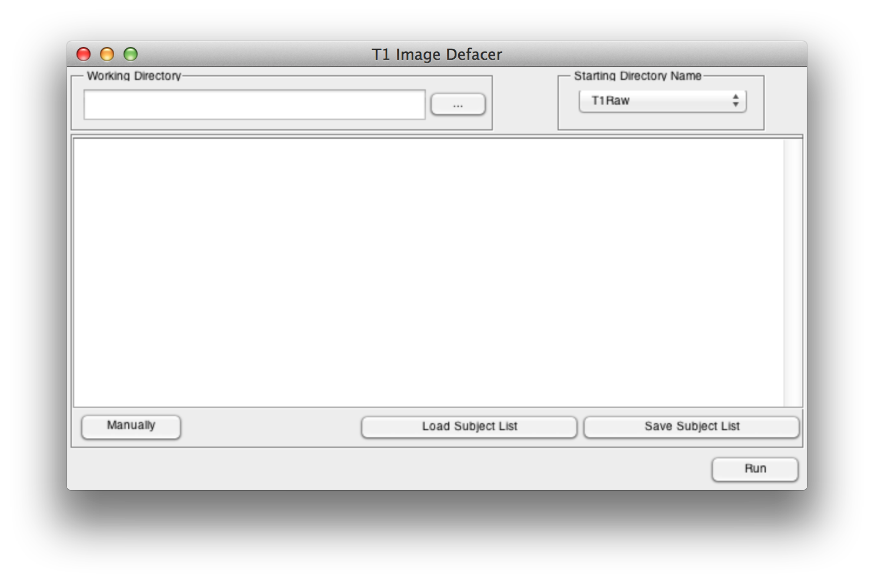

Slide 14
Outline
Overview
Data Preparation
Preprocessing
R-fMRI measures Calculation
Quality Control
Standardization
Statistical Analysis
Results Viewing
14

Slide 17
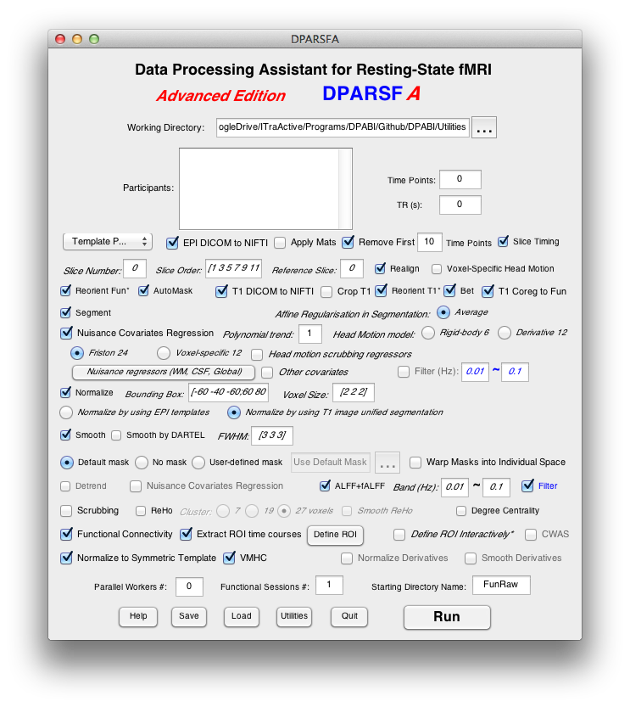
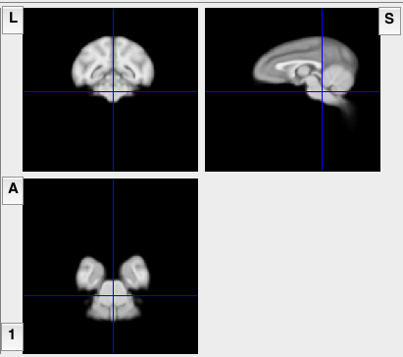
DPARSF for Monkey Data
The monkey module is based on Rhesus Macaque Atlases for functional and structural imaging studies generated by Wisconsin ADRC Imaging Core. Please cite these papers when appropriate: McLaren, D.G., Kosmatka, K.J., Oakes, T.R., Kroenke, C.D., Kohama, S.G., Matochik, J.A., Ingram, D.K., Johnson, S.C., 2009. A population-average MRI-based atlas collection of the rhesus macaque. Neuroimage 45, 52-59.; McLaren, D.G., Kosmatka, K.J., Kastman, E.K., Bendlin, B.B., Johnson, S.C., 2010. Rhesus macaque brain morphometry: a methodological comparison of voxel-wise approaches. Methods 50, 157-165.
17

Slide 20
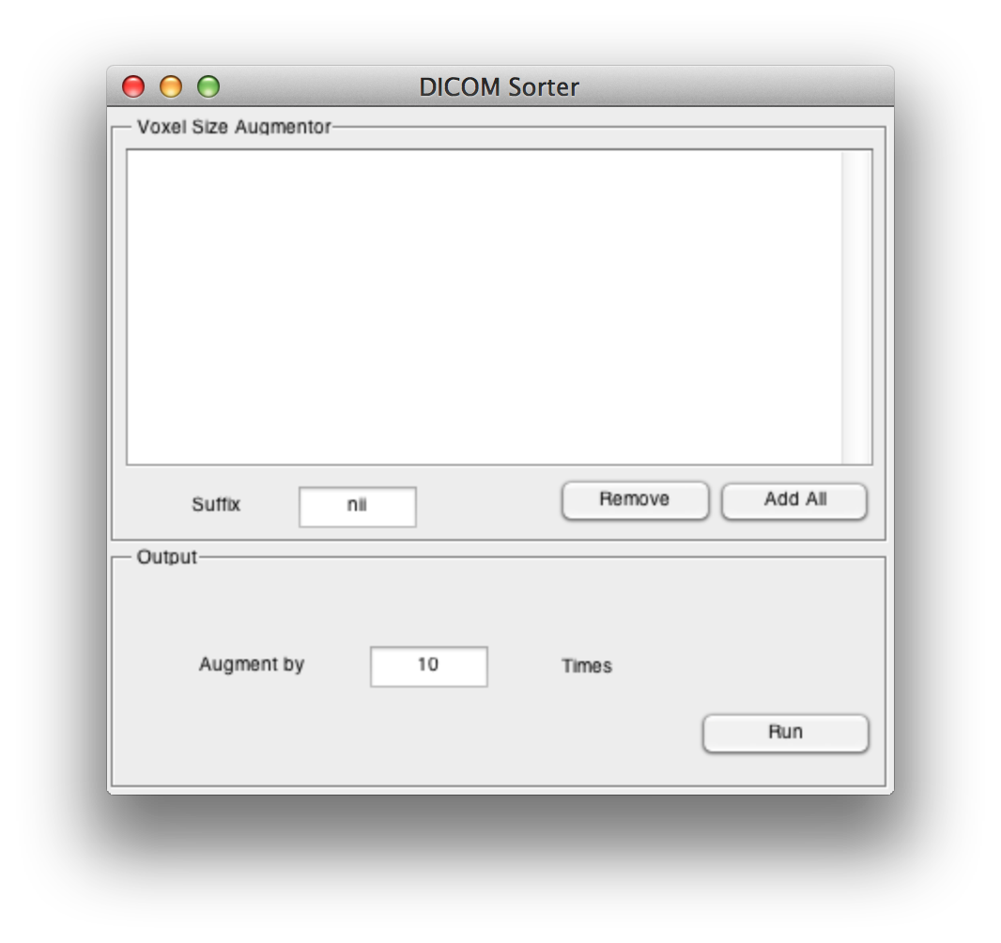

Slide 21
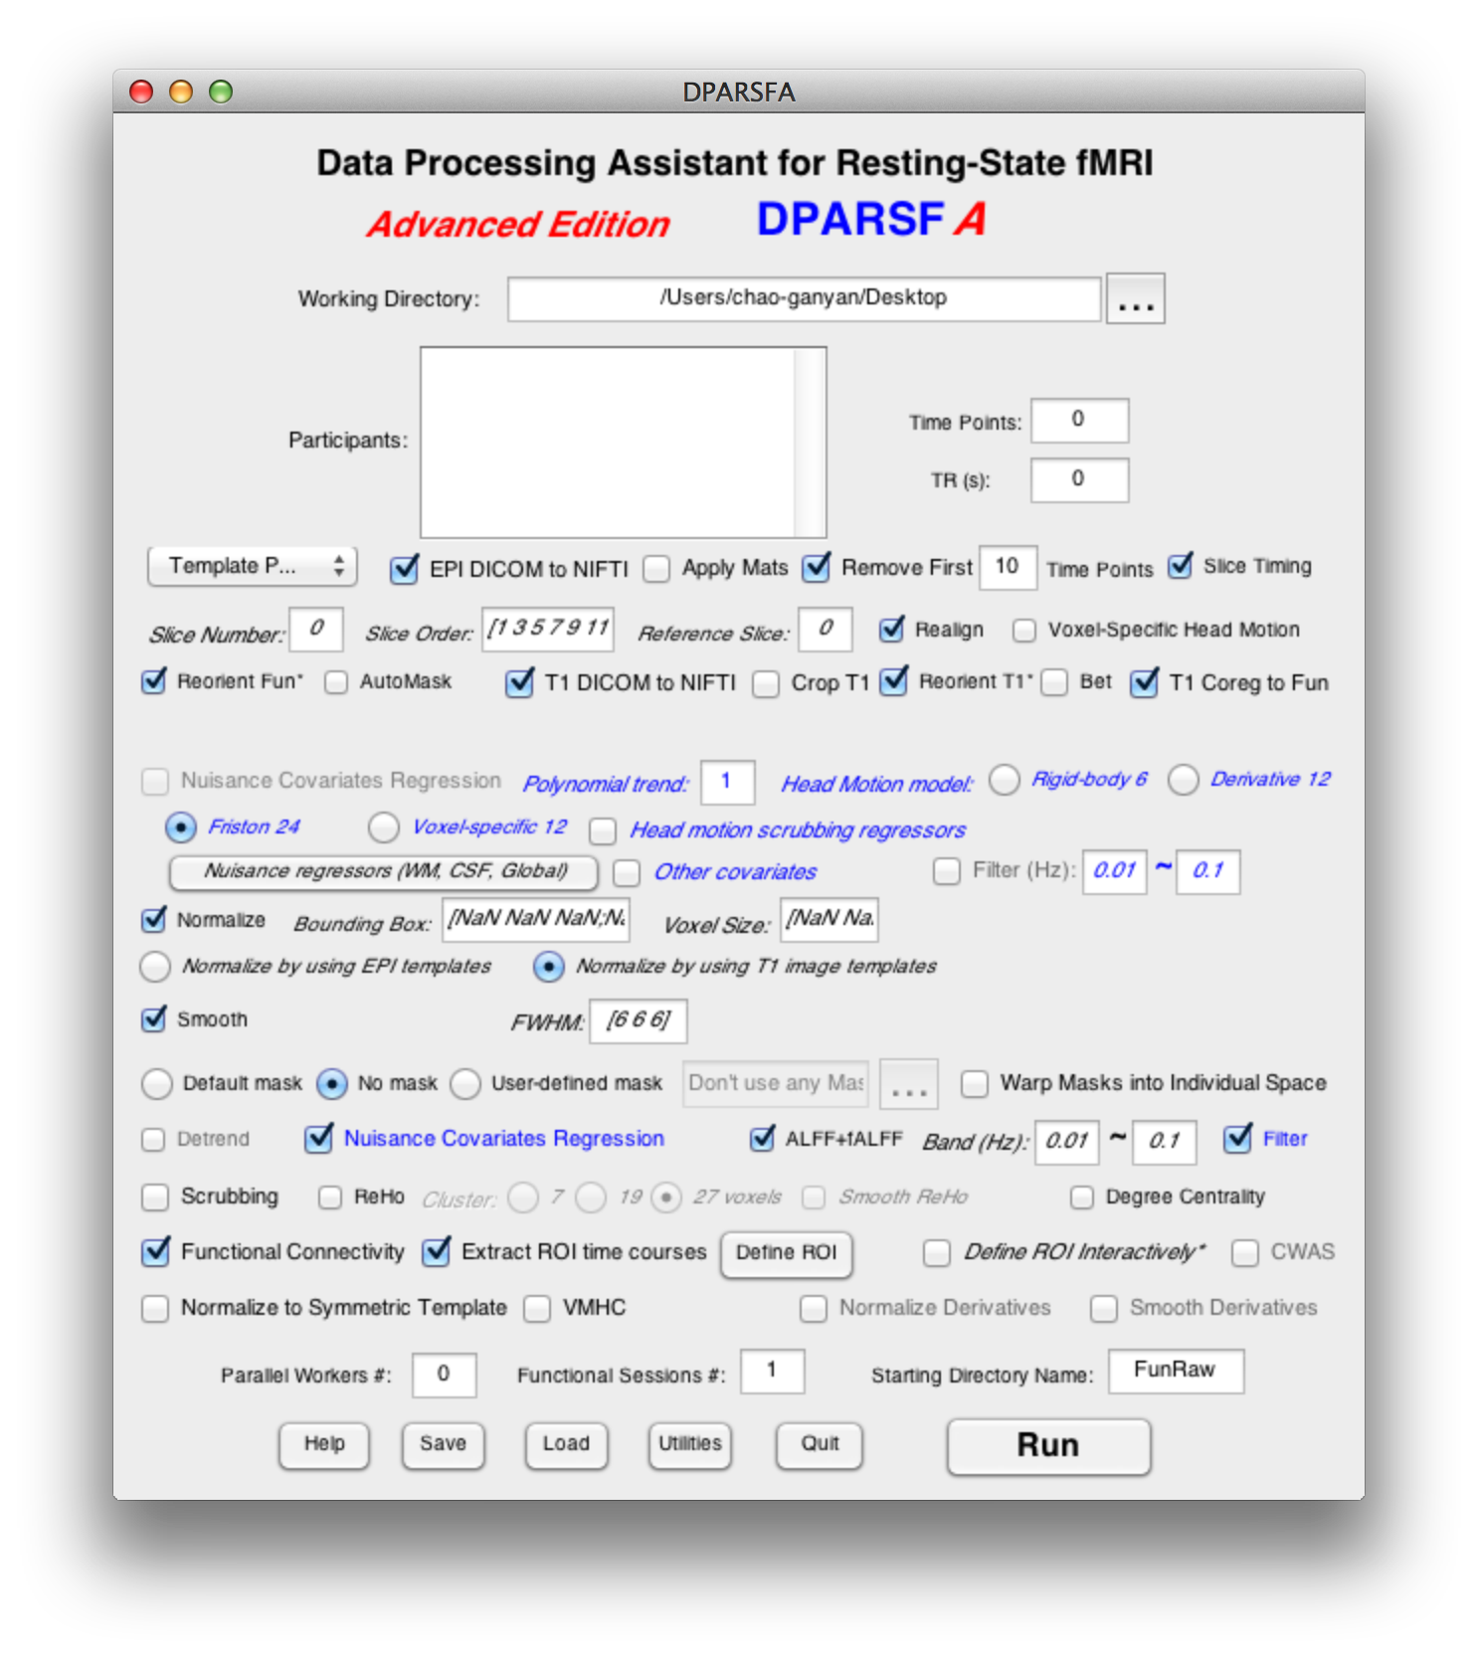
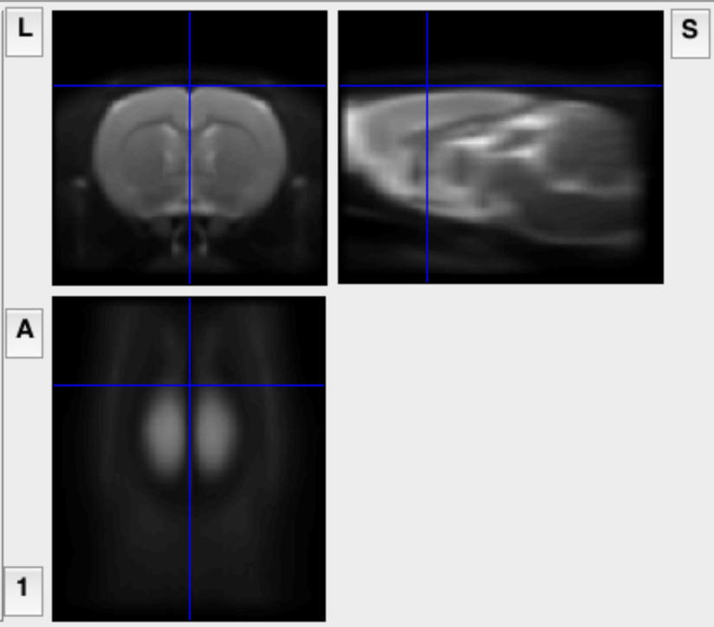
DPARSF for Rat Data
The Rat module is based on a Rat T2 template generated by Dr. Adam J. Schwarz et al. Please cite this paper when appropriate: Schwarz, A.J., Danckaert, A., Reese, T., Gozzi, A., Paxinos, G., Watson, C., Merlo-Pich, E.V., Bifone, A., 2006. A stereotaxic MRI template set for the rat brain with tissue class distribution maps and co-registered anatomical atlas: application to pharmacological MRI. Neuroimage 32, 538-550. (A T1 template was included as well. It’s generated by normalizing 50 rats (two scans at PND45 or PND60) to that T2 template and then averaging (by Dr. Chao-Gan Yan)).
21

Slide 22
Outline
Overview
Data Preparation
Preprocessing
R-fMRI measures Calculation
Quality Control
Standardization
Statistical Analysis
Results Viewing
22

Slide 23
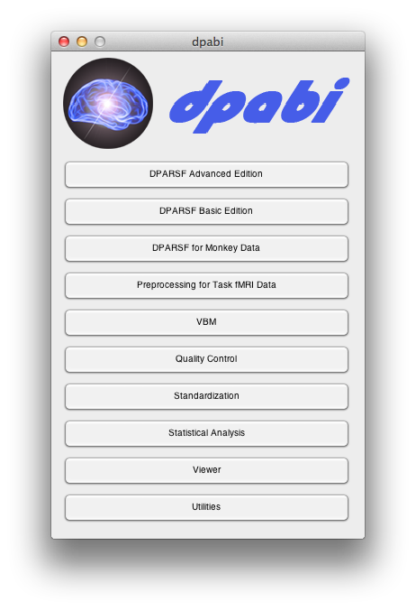

Slide 24
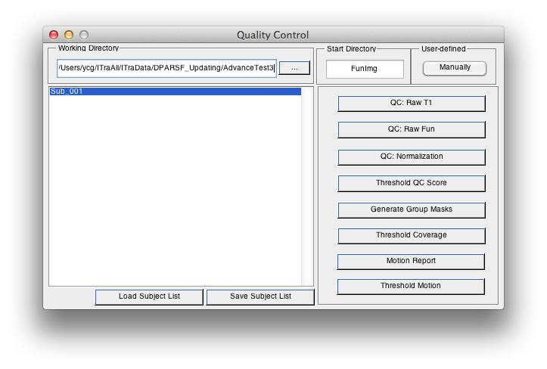
Quality Control
24

Slide 25
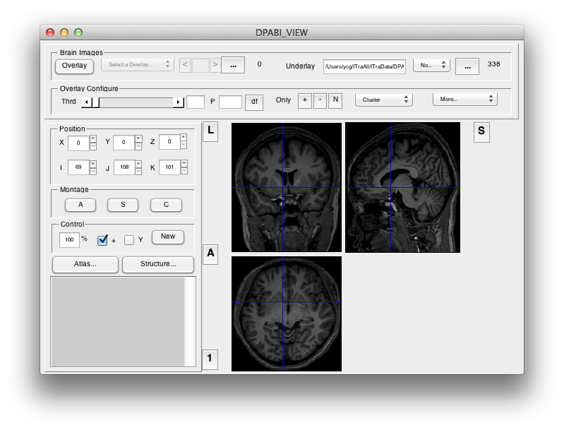
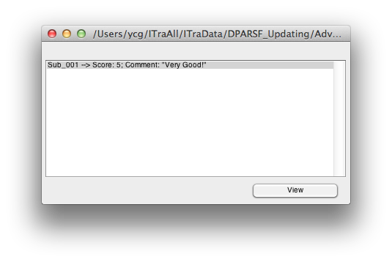
Quality Control
25

Slide 26
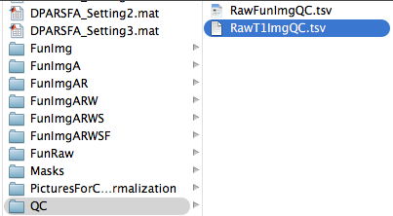

Quality Control
26

Slide 27
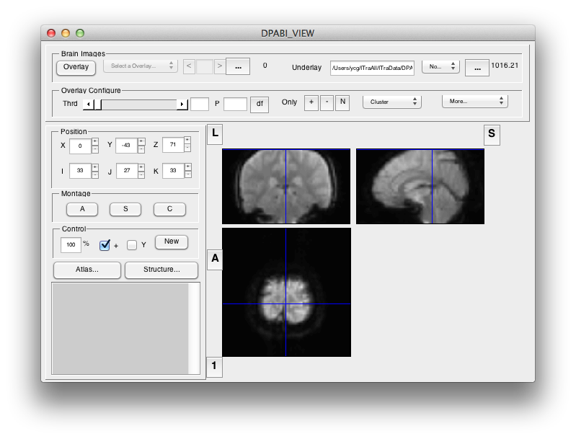
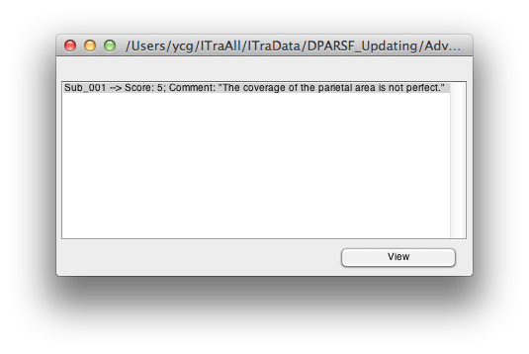
Quality Control
27

Slide 28
Quality Control
28

Slide 29
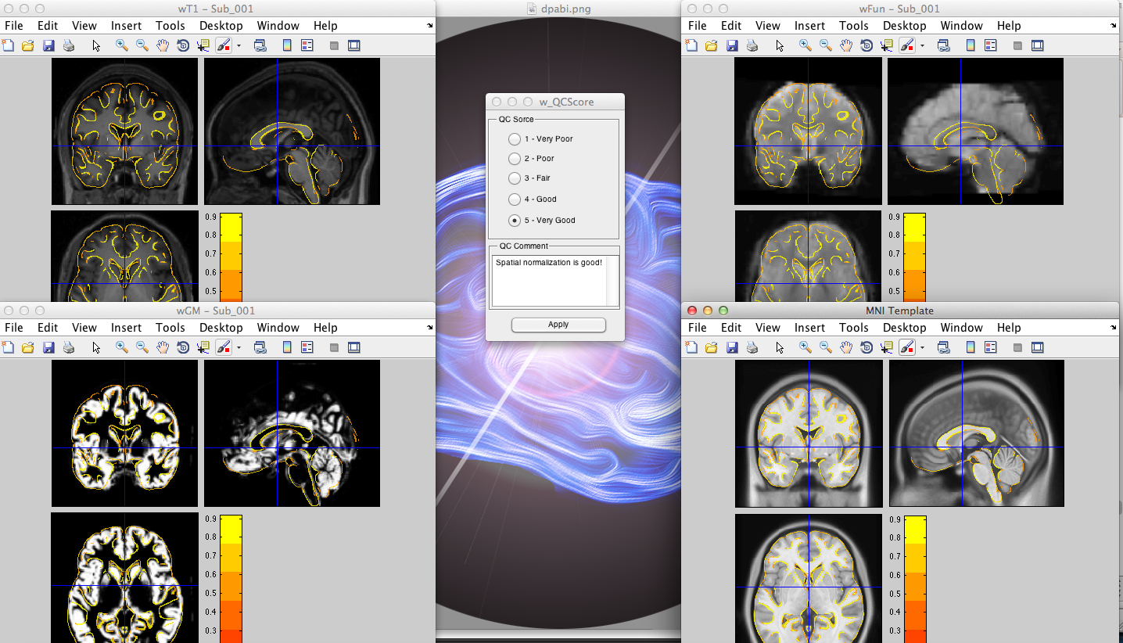
Quality Control
29

Slide 30
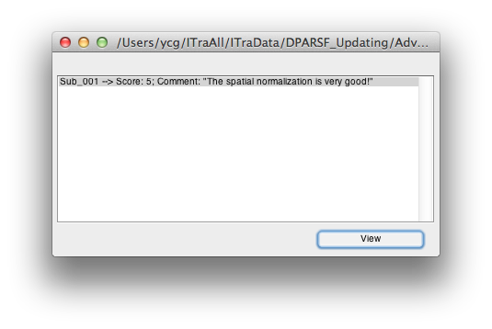
Quality Control
30

Slide 31
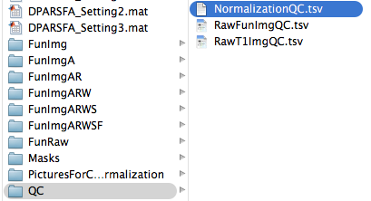

Quality Control
31

Slide 32
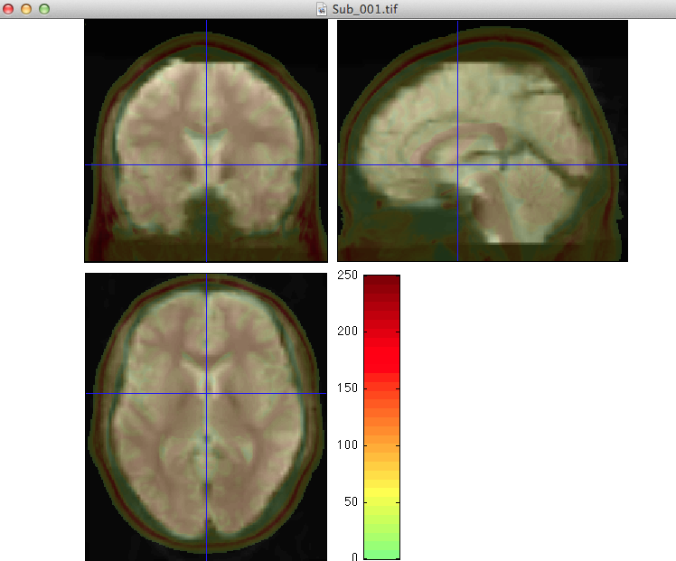
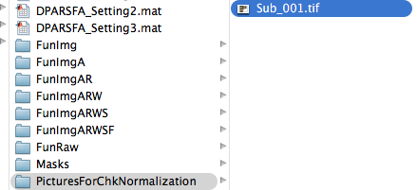
Quality Control
32

Slide 33
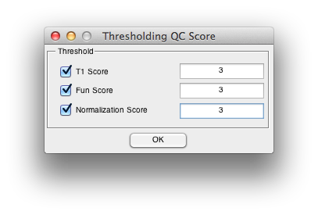
Quality Control
33

Slide 34
Quality Control
34

Slide 35
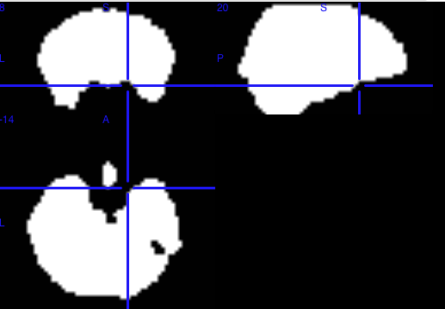
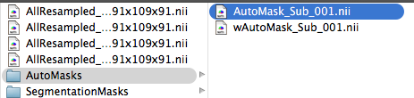
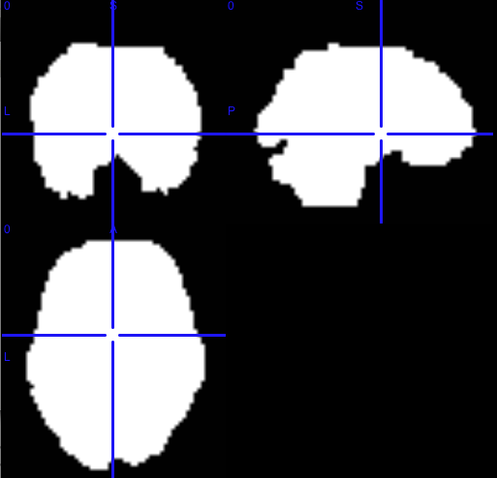
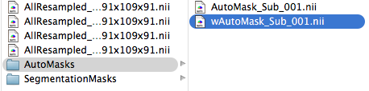
Quality Control
35

Slide 36
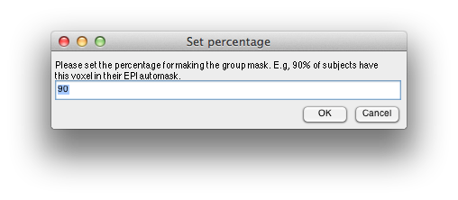
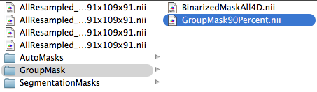
Quality Control
This mask is very important for group statistical analysis!!!
36

Slide 37
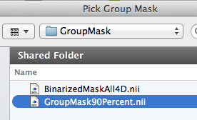
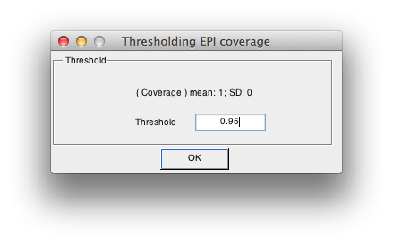
Quality Control
37

Slide 38
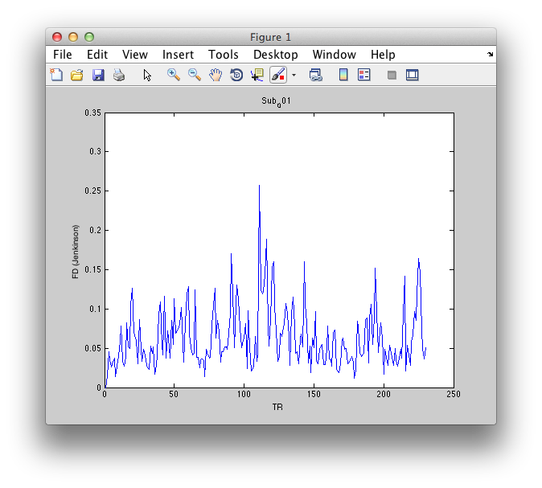
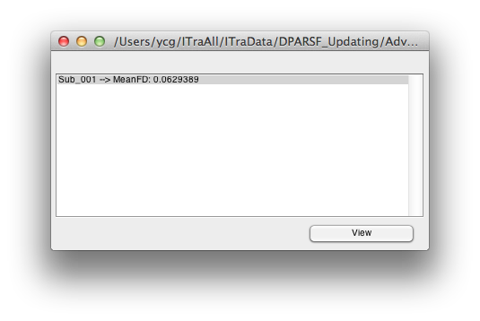
Quality Control
38

Slide 39
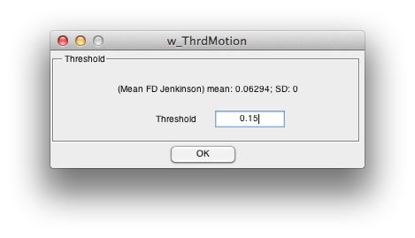
Quality Control
39

Slide 40
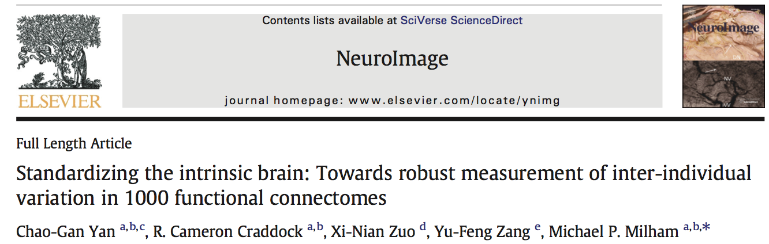
Quality Control
Using the visual inspection step within DPARSF, subjects showing severe head motion in the T1 image and subjects showing extremely poor coverage in the functional images, as well as subjects showing bad registration were excluded
Subjects with overlap with the group mask (voxels present at least 90% of the participants) less than 2*SD under the group mean overlap (threshold: 92.2%) were excluded
Subjects with motion (Mean FD Jenkinson greater than 2*SD above the group mean motion (threshold: 0.192) were excluded
Yan et al., 2013, Neuroimage
40

Slide 41
Outline
Overview
Data Preparation
Preprocessing
R-fMRI measures Calculation
Quality Control
Standardization
Statistical Analysis
Results Viewing
41

Slide 43

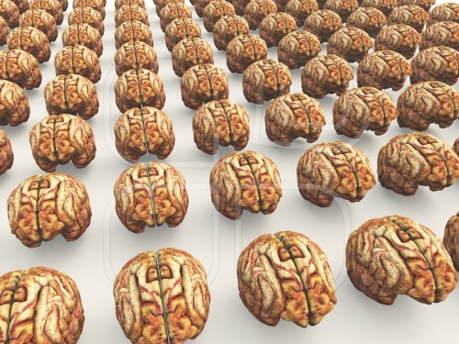
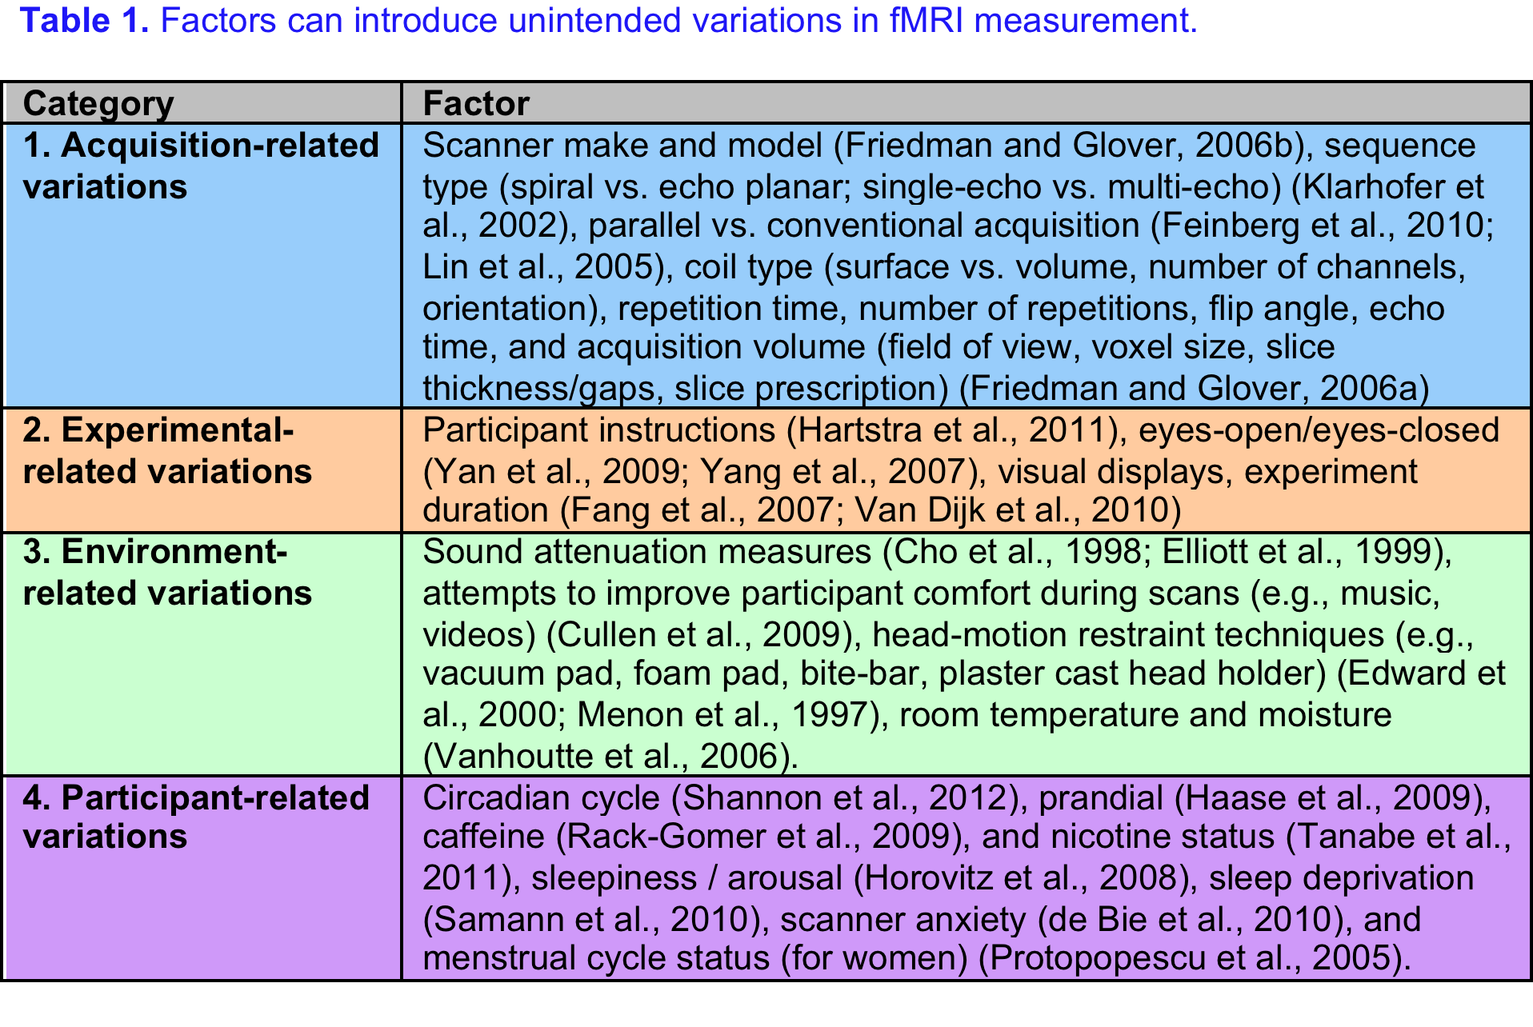
Standardization
Yan et al., 2013. Neuroimage

Slide 44
Standardization
Yan et al., 2013. Neuroimage

Slide 45
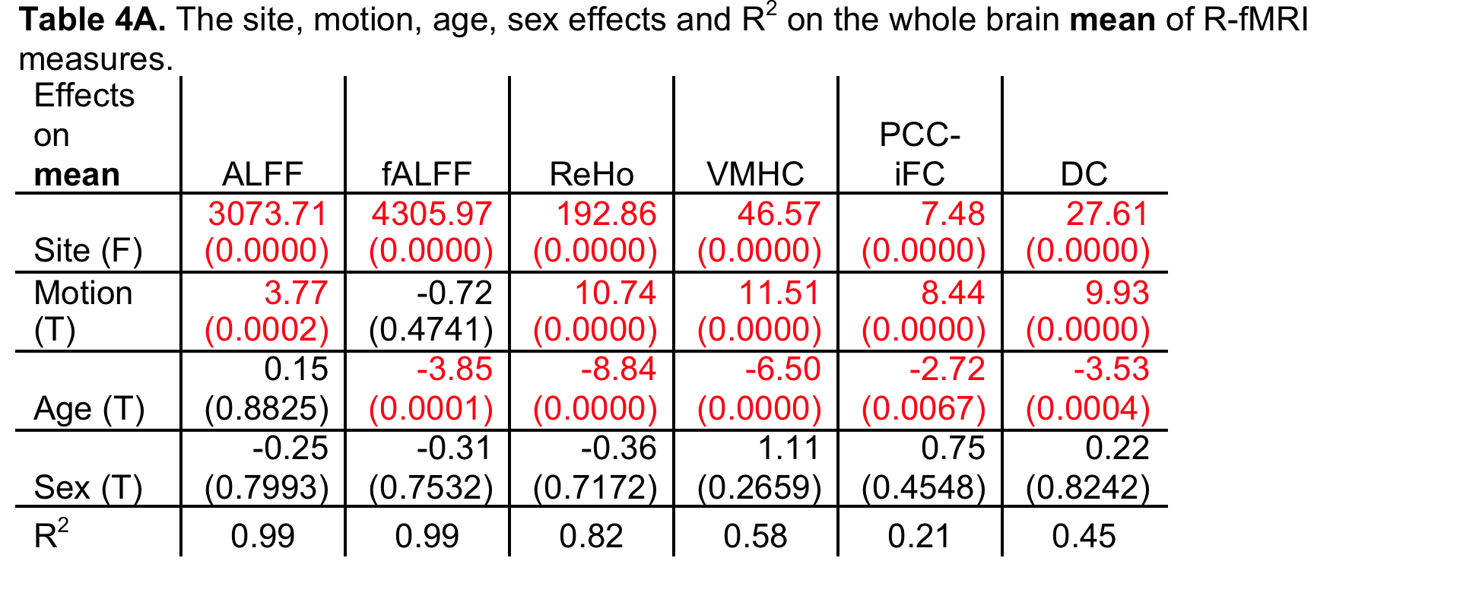
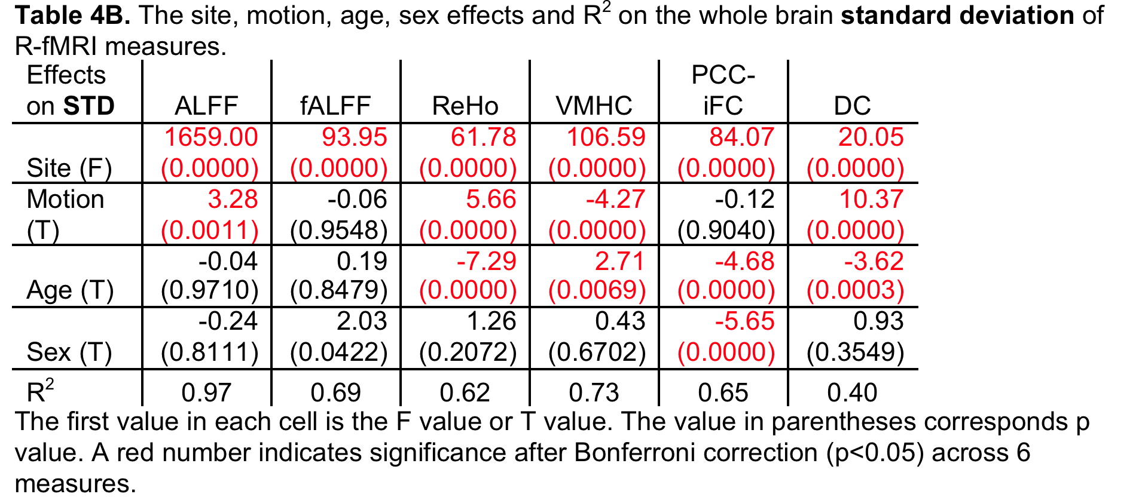
Standardization
Methodological Issues
Yan et al., 2013. Neuroimage

Slide 46
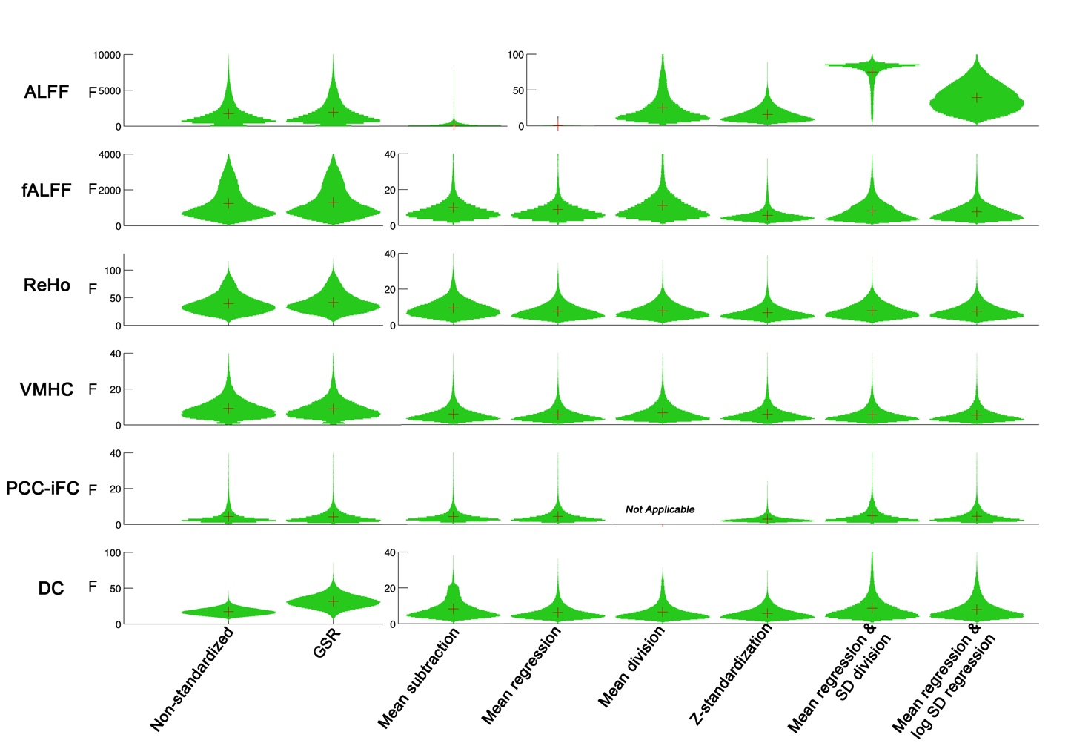
Standardization
Standardization
Yan et al., 2013. Neuroimage

Slide 47
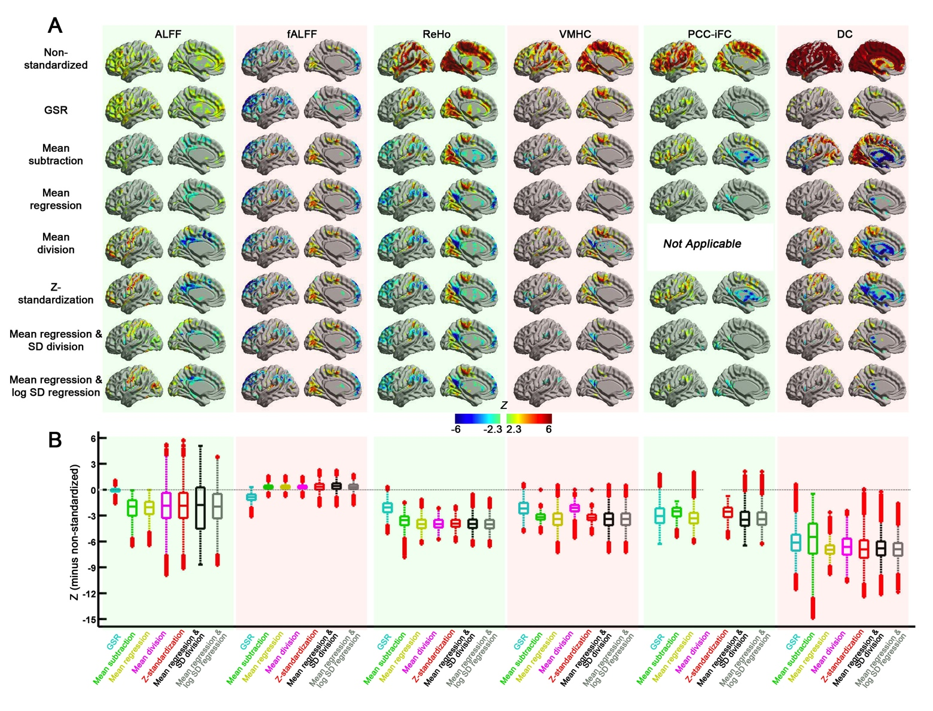
Standardization
Yan et al., 2013. Neuroimage

Slide 48
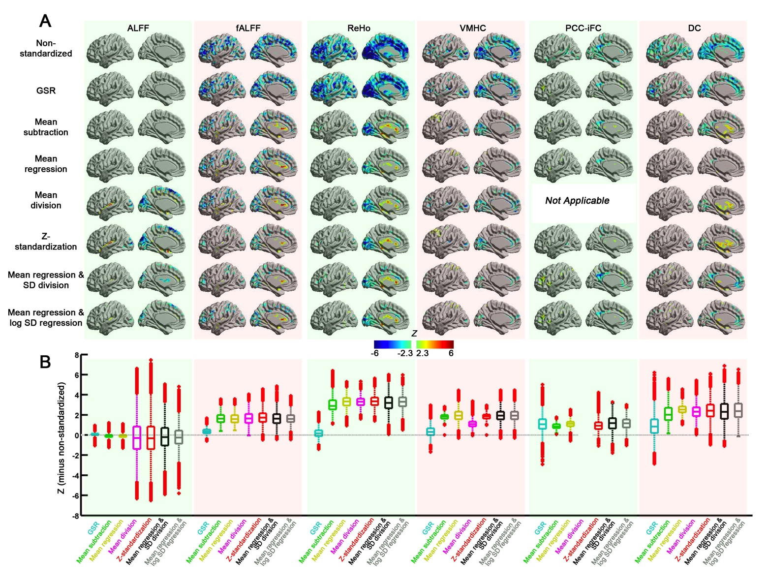
Standardization
Methodological Issues
Yan et al., 2013. Neuroimage

Slide 49
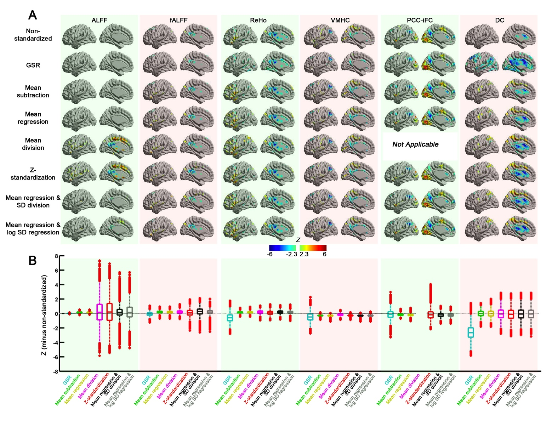
Standardization
Yan et al., 2013. Neuroimage

Slide 50

Standardization
Yan et al., 2013. Neuroimage

Slide 51

Standardization
Standardization
Yan et al., 2013. Neuroimage

Slide 52
Standardization
Mean regression-based approach.
Mean regression + SD division (for controlling mulplicative effects).

Slide 53

Standardization

Slide 54
Outline
Overview
Data Preparation
Preprocessing
R-fMRI measures Calculation
Quality Control
Standardization
Statistical Analysis
Results Viewing
54

Slide 56


Statistical Analysis
56

Slide 57

One-Sample T-Test
0 for z* images
1 for m* images
T Statistic Image
Group Mask

Slide 58

Two-Sample T-Test
T Statistic Image: positive corresponds to the mean of Group 1 is greater than the mean of Group 2

Slide 59


Two-Sample T-Test
Two-Sample T-Test with covariates: e.g. gray matter proportion images (Oakes et al., 2007, Neuroimage)
Please make sure the correspondence between the group images and the covariate images: order and voxel size
Other covariate can be also specified as text files. (E.g. age, brain size, IQ etc.)

Slide 60

Paired T-Test
T Statistic Image
Condition 1 – Condition 2
Please make sure the correspondence

Slide 61

ANOVA or ANCOVA
ANCOVA: e.g. gray matter proportion images (Oakes et al., 2007, Neuroimage)
F Statistic Image
Please make sure the correspondence between the group images and the covariate images: order and voxel size
Other covariate can be also specified as text files. (E.g. age, brain size, IQ etc.)

Slide 62

ANOVA or ANCOVA
Multiple Comparisons

Slide 63

Multiple comparisons for ANOVA
Tukey-Kramer (HSD)
Bonferroni
Dunn-Sidak
Scheffe control
Differences on means
Corrected p values
Corresponded Z values

Slide 64

ANOVA (Repeated Measures)
Intra-subject design

Slide 65

Correlation Analysis
Traits: e.g.
MMSE.txt
19
15
…
The imaging measure:
ALFF maps

Slide 66

Statistical Analysis
{DPABI_Dir}/StatisticalAnalysis/y_GroupAnalysis_Image.m
66

Slide 67

Attention!!!
67

Slide 68
Statistical Analysis
{DPABI_Dir}/StatisticalAnalysis/y_GroupAnalysis_Image.m
Smoothness estimation based on the 4D residual is built in this function!!!
68

Slide 69
Statistical Analysis
http://rfmri.org/DemoData
{Download}/ProcessingDemoData/StatisticalDemo/AD_MCI_NC/
ALFF: AD – NC Two Sample T Test:
Applied smooth kernel in preprocessing: [4 4 4]
Smooth kernel estimated on 4D residual: [6.77 6.88 6.71]
Smooth kernel estimated on statistical image (T to Z, as in easythresh): [6.90 7.33 6.94]
ReHo: AD – NC Two Sample T Test:
Applied smooth kernel in preprocessing: [4 4 4]
Smooth kernel estimated on 4D residual: [8.10 8.50 7.93]
Smooth kernel estimated on statistical image (T to Z, as in easythresh): [8.33 8.94 8.24]
Thus, only using smooth kernel applied in preprocessing is NOT sufficient!!!
69

Slide 70
Multiple Comparison Correction
70

Slide 71
Multiple Comparisons
P=0.05
Probability of not getting a false positive result:
1 - 0.05 = 0.95
P=0.05
Probability of not getting a false positive result:
1 - 0.05 = 0.95
P=0.05
Probability of not getting a false positive result:
1 - 0.05 = 0.95
P=0.05
Probability of not getting a false positive result:
1 - 0.05 = 0.95
P=0.05
Probability of not getting a false positive result:
1 - 0.05 = 0.95
0.95 0.95 0.95 0.95 0.95
0.95⁵=0.774

Slide 72
Multiple Comparisons
Bonferroni correction: 0.05/5=0.01
Family-Wise Error (FWE) correction
False Discovery Rates (FDR) correction
Monte Carlo simulations (AlphaSim)

Slide 73

FDR Theory
False discovery rate Q_{e}=E(V/(V+S))=E(V/R)
Benjamini and Hochberg, 1995, Journal of the Royal Statistical Society
73
Notes:
73

Slide 74
FDR Theory
Let H₁, …, H_{m} be the null hypotheses and P₁, …, P_{m} their corresponding p-values. Order these values in increasing order and denote them by P₍₁₎, …, P_{(m)}. For a given q, find the largest k such that P_{(k)} ≦ kq/m.
Then reject (i.e. declare positive) all H_{(i)} for i = 1, …, k.
74
Notes:
74

Slide 75

FDR in REST
75
Notes:
75

Slide 76

FDR
76
Notes:
76

Slide 77
Multiple Comparisons
Gaussian Random Field Theory Correction
Monte Carlo simulations (AlphaSim)
?

Slide 78


78

Slide 79

Voxel Z > 2.3, Cluster P < 0.05, Two One-Tailed Corrections:
equivalent to
Voxel P < 0.0214, Cluster P < 0.1, Two Tailed.

Slide 80


Slide 81
Cl Size Frequency Cum Prop p/Voxel Max Freq Alpha
1 235971 0.619898 0.009613 0 1.000000
2 76150 0.819945 0.006282 0 1.000000
3 32297 0.904789 0.004131 0 1.000000
4 15940 0.946664 0.002763 0 1.000000
5 8476 0.968930 0.001863 0 1.000000
6 4786 0.981503 0.001265 1 1.000000
7 2767 0.988772 0.000860 19 0.999000
8 1606 0.992991 0.000586 51 0.980000
9 1011 0.995647 0.000405 127 0.929000
10 585 0.997184 0.000276 132 0.802000
11 391 0.998211 0.000194 172 0.670000
12 236 0.998831 0.000133 146 0.498000
13 164 0.999262 0.000093 107 0.352000
14 98 0.999519 0.000063 78 0.245000
15 69 0.999701 0.000043 61 0.167000
16 37 0.999798 0.000029 30 0.106000
17 22 0.999856 0.000020 22 0.076000
18 22 0.999913 0.000015 21 0.054000
19 11 0.999942 0.000010 11 0.033000
20 7 0.999961 0.000007 7 0.022000
21 5 0.999974 0.000005 5 0.015000
22 5 0.999987 0.000003 5 0.010000
23 4 0.999997 0.000002 4 0.005000
24 1 1.000000 0.000000 1 0.001000

Slide 82
Outline
Overview
Data Preparation
Preprocessing
R-fMRI measures Calculation
Quality Control
Standardization
Statistical Analysis
Results Viewing
82

Slide 84


Slide 85

85

Slide 86


Slide 87

87

Slide 88


Slide 89
89

Slide 90
Voxel Z > 2.3, Cluster P < 0.05, Two One-Tailed Corrections:
equivalent to
Voxel P < 0.0214, Cluster P < 0.1, Two Tailed.

Slide 91


Slide 92



Slide 93

93

Slide 94

94

Slide 95
95

Slide 96

96

Slide 97
Utilities
97

Slide 98

98

Slide 99


Define ROI
Multiple labels in mask file: each label is considered as one ROI
Dosenbach et al., 2010
Andrews-Hanna et al., 2010
Craddock et al., 2011
Define other ROIs
99

Slide 100


Slide 101


Slide 102




Slide 104


[r p]=corrcoef(ALFF,MMSE)
plot(ALFF,MMSE,’o’)
lsline
Scatter
Plot

Slide 105

Image
Reslicer

Slide 106

Image Calculator

Slide 107
Image Calculator
Example expressions:
(a) g1-1 Subtract 1 from each image in group 1
(b) g1-g2 Subtract each image in group 2 from each corresponding image in group1
(c) i1-i2 Subtract image 2 from image 1
(d) i1>100 Make a binary mask image at threshold of 100
(e) g1.*(i1>100) Make a mask and then apply to each image in group 1
mean(g1) Calculate the mean image of group 1
(i1-mean(g1))./std(g1) Calculate the z value of i1 related to group 1
(g) corr(g1,g2,''temporal'') Calculate the temporal correlation between two groups, i.e. one correlation coefficient between two ''time courses'' for each voxel.
(h) corr(g1,g2,''spatial'') Calculate the spatial correlation between two groups, i.e. one correlation coefficient between two images for each ''time point''.

Slide 108
Reading and Writing functions
Reading:
[Data Header] = y_Read('brodmann.nii');
Data – 181*217*181 double
Header – Structure
Processing:
BA20Data = (Data==20);
Writing:
y_Write(BA20Data, Head, 'BA20.img');
y_ReadRPI
y_ReadAll

Slide 109

The R-fMRI Maps Project
109

Slide 110

The R-fMRI Maps Project
Insel and Cuthbert 2015. Science
110

Slide 111


The R-fMRI Maps Project
111

Slide 112
The R-fMRI Maps Project
Here is a list of R-fMRI indices shared:
Amplitude of low frequency fluctuations (ALFF)
Fractional ALFF (fALFF)
Regional Homogeneity (ReHo)
Voxel-mirrored homotopic connectivity (VMHC)
Degree Centrality (DC)
Functional Connectivity Matrices of
Automated Anatomical Labeling (AAL) atlas
Harvard-Oxford atlas
Craddock’s clustering 200 ROIs
Zalesky’s random parcelations
Dosenbach’s 160 functional ROIs
In addition, the gray matter (GM), white matter (WM) and cerebrospinal fluid (CSF) density and volume are shared as well.
Please see xxxx/xxx for the details of the data processing steps.
112

Slide 113

The R-fMRI Maps Project
Template Parameter
V4: Calculate in MNI Space (warp by DARTEL)
113

Slide 114

The R-fMRI Maps Project
1. Organize Results
2. Compress
3. Upload
Save the KEY intermediate files for future processing
(save disk space)
114

Slide 115

The R-fMRI Wiki
115

Slide 116
Further Help
Further questions:
http://rfmri.org/dpabi
http://dpabi.org
The R-fMRI Network
116

Slide 117


Further Help
117

Slide 118


118

Slide 119

119

Slide 120


Send emails only to rfmri.org@gmail.com: 1) sending new email means you are posting your personal blogs, 2) replying email means you are posting comments to that topic/blog, 3) then all the other R-fMRI nodes will receive email updates of your posts.
120

Slide 121


121

Slide 122
Acknowledgments
Chinese Academy of Sciences Xi-Nian Zuo
NYU Child Study Center
F. Xavier Castellanos
Hangzhou Normal University Yu-Feng Zang
Child Mind Institute
Michael P. Milham
Beijing Normal University
Yong He
Xin-Di Wang
Nathan Kline Institute
Charles Schroeder
Peking University
Tian-Mei Si
Notes:
Different Axis!!!

Slide 123
Thanks for your attention!
123

